Slide 1

CMN 1160A – Introduction to Media Studies
Week 4A: Media: History, Culture and Politics
Daniel J. Paré
University of Ottawa, Department of Communication
September 27, 2016
Notes:
1

Slide 2
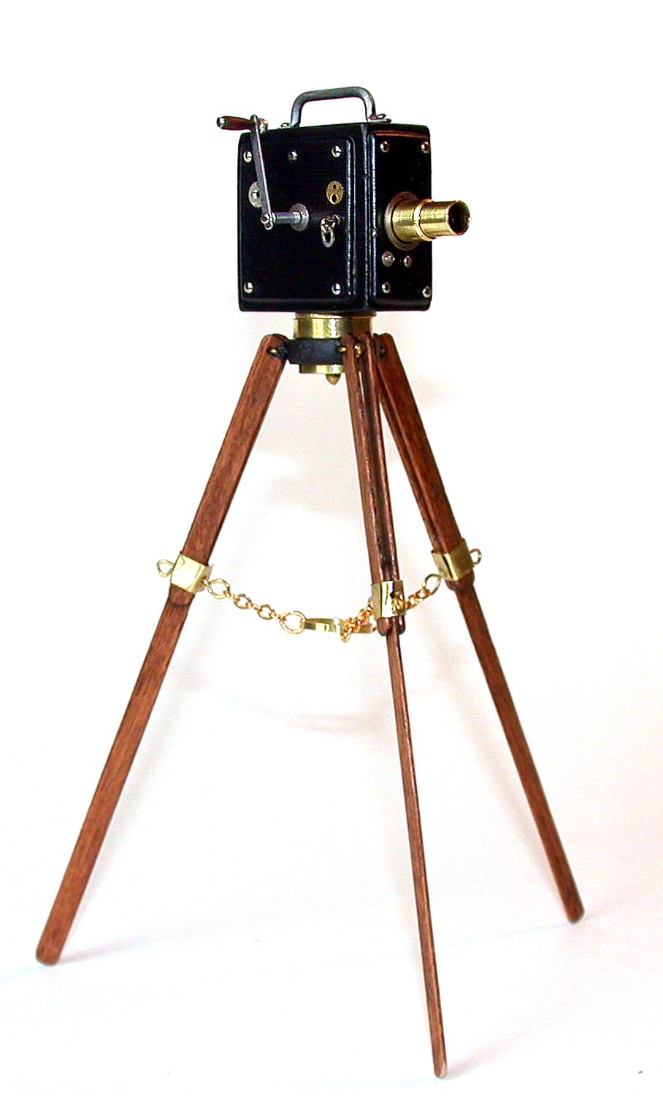
A Brief History of Film
1897: first film shot and produced in Canada
1913: first Canadian feature film – Evangeline
D.W. Griffith’s Birth of a Nation – first feature length Hollywood film
1920s: Hollywood hey-day – start of the studio system
Mary Pickford and Mack Sennett, early Canadian Hollywood stars
Hollywood’s view of Canada: Mounties, bush pilots, frozen wasteland
Notes:
2

Slide 3
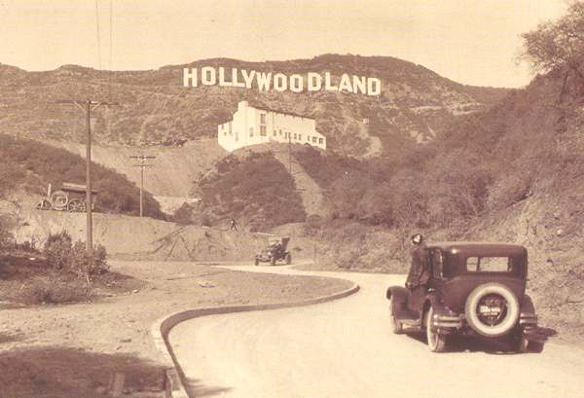
Hollywood in Crisis – the 1950s
House UnAmerican Activities Commission – Reds in Hollywood
1949 ‘Break-Up’ movie industry – forced to divest theatre chains
Advent of television
Notes:
3

Slide 4
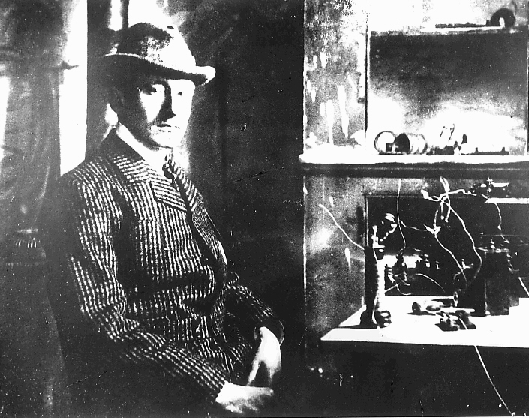
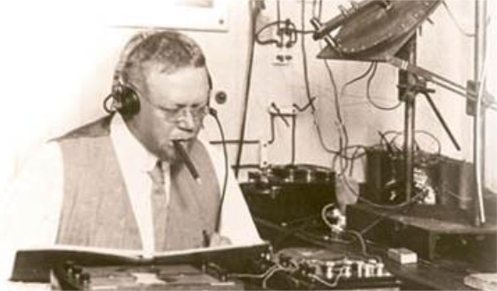
A Brief History of Radio
Outgrowth of radio telegraphy
Marconi and Fessenden
Dec. 1901 – ‘S’ from UK to Newfoundland
1906 – Xmas eve 1906 music broadcast to ships
1919: first broadcast licence issued in Canada (WXA Montreal)
1920s – dramatic growth in radio
1932 – CBC Radio established
1930s/1940s – Golden Age of radio

Slide 5

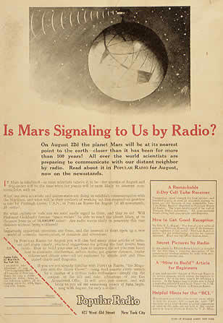

Slide 6
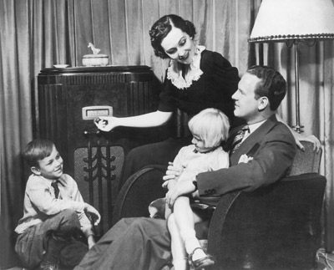
Promise of Radio
Radio will lead to greater educational benefits
Radio will lead to greater political transparency and better democracy
Radio will lead to better diffusion of religion
Have you heard this before?

Slide 7
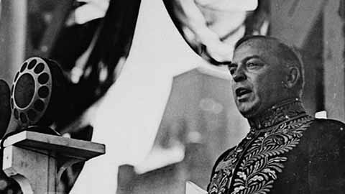
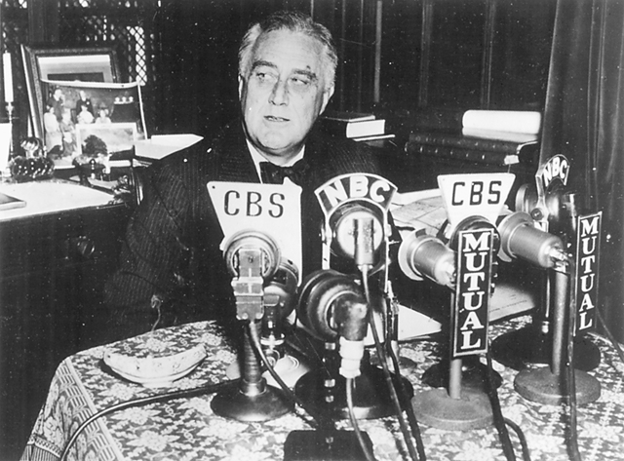

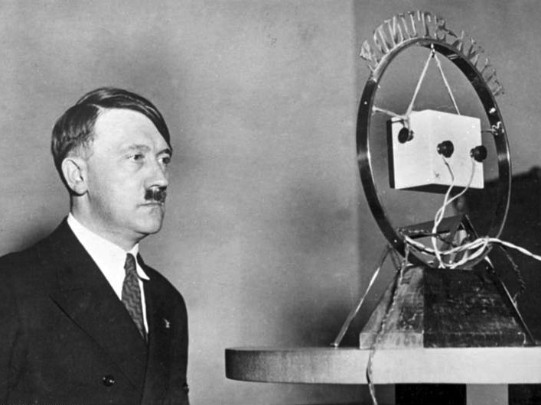


Slide 8

A Brief History of Television
1939: TV demonstrated at NY World’s Fair & at Canadian National Exhibition
1947: 1st permanent TV network (NBC)
1952: TV arrives in Canada (CBC TV and CBFT in Mt; CBLY in T.O)
1958a: Fowler Commission
1958b: CBC from Victoria to Halifax
1958c: CTV - first private broadcaster in Cda
1966: Colour TV arrives in Canada
1997: Web TV
2001: First wave of digital specialty channels is launched in Canada
2005: Canadian channels begin broadcasting in HDTV

Slide 9
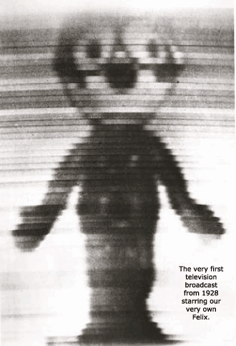

Slide 10
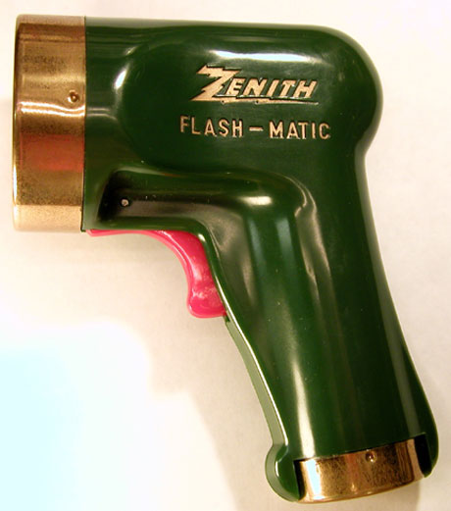

Slide 11
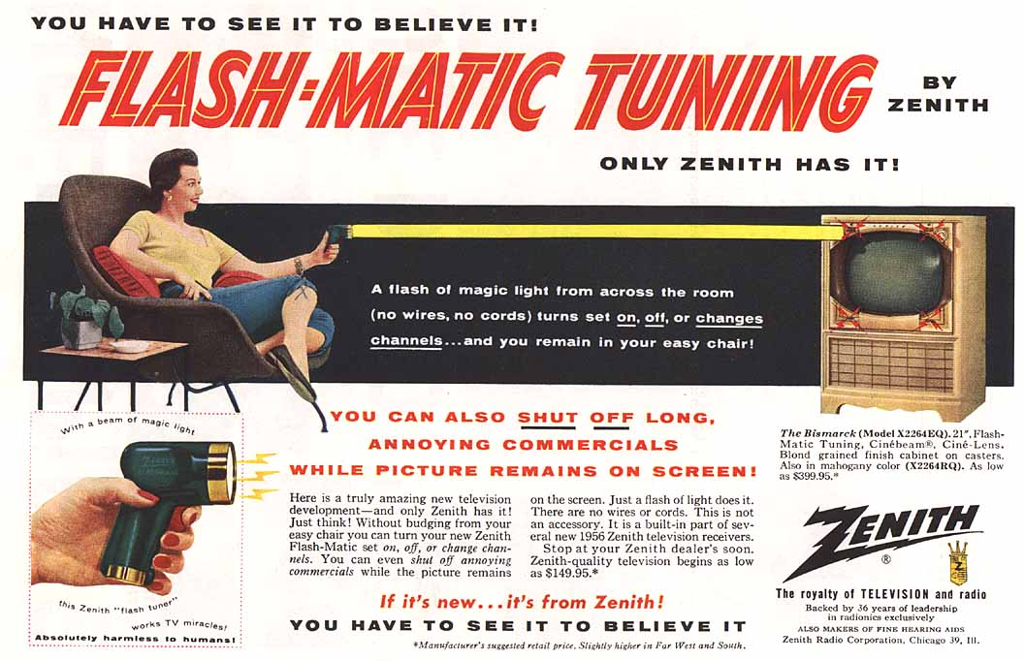

Slide 12

Mass Media Shake-Up
Evening Telecasts – afternoon newspapers dropped
Magazines – loss of advertisers
Hollywood – demassification
Radio – demassification
Notes:
12

Slide 13

So where does that leave us?
Notes:
13

